Slide 1


Slide 2

AGENDA
01
02
03
04
05
06
About me
Project title
Problem statement
Project overview
End users
Tools and technologies
07
08
09
10
11
quiz design and layout
Features and functionality
results and screenshots
conclusion
GitHub link

Slide 3

STUDENT NAME: Priyadharshini V
REGISTER NO: 222403584
NMID: asunm285222403584
DEPARTMENT COLLEGE: Sridevi acts and science collage
madras university

Slide 4
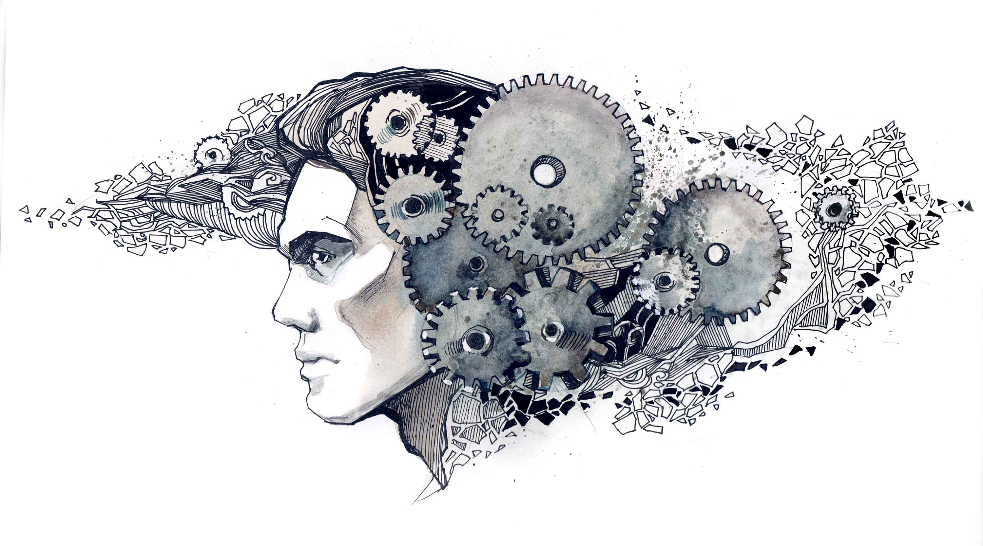

Slide 5

Problem statement
In the modern digital era, traditional learning and assessment methods areshifting
toward online platforms. Students, teachers, and organizations need interactive and reliable
systems for conducting quizzes, assessments, and self-evaluations. However, many existing
quiz platforms are either too complex, lack user-friendly interfaces, or fail to provide
real-time feedback and progress tracking.

Slide 6

Project overview
Provides an online
platform for quizzes.
Gives instant results
and feedback.
Allows teachers to
createand manage
quizzes

Slide 7

Who are the end users?
General
Learners
to improve skills
and learning.
Institutions/
Schools
to conduct
assessments.
Teachers
to create and
assign quizzes.
Students
to practice and
test knowledge.

Slide 8
Tools And Techniques
04
01
02
03
CSS :
Styling
(colors, layouts,
responsiveness).
JavaScript :
Interactivity
(navigation menu,
animations,
form validation)
Mention code editor
(VS Code) or CODEPEN
and hosting platform
(GitHub Pages)
HTML :
Structure
(pages, sections).

Slide 9
Quiz design and layout
Quiz Interface
shows one question at a time with options.
Timer Display
countdown for time-
bound quizzes.
3
4
Result Page
shows score, correct/
incorrect answers.
Login/Signup Page
for user access
and tracking.
2
5
Homepage
simple start screen
with quiz categories.
6
Admin Panel
for teachers to add/
manage quizzes.
1

Slide 10

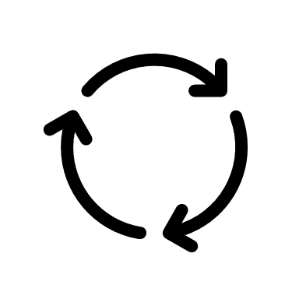
Features and functionality
User-Friendly Interface
Simple navigation with clean design for smooth quiz experience.
Question Bank
Multiple-choice, true/false, and timed questions with randomization.
Scoring & Feedback
Automatic score calculation with instant feedback on answers.
Timer & Progress Tracking
Countdown timer and progress bar for each quiz attempt .
Results & Leaderboard
Display detailed results, rankings, and performance history.

Slide 11

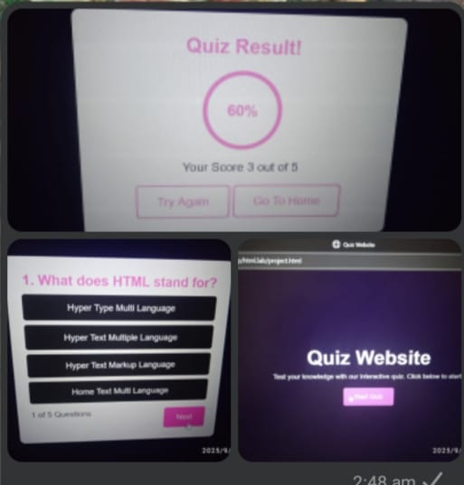
Results and screenshot

Slide 12

conclusion
Improves learning
Quick feedback
Easy to use

Slide 13

GitHub Link
https://github.com/vpriyadharshini24133bsccs/Priyadharshini_222403584.git

Slide 14





Thanks For Watching

